Slide 1


Slide 2
Overview
Know about an accelerometer
Interface with the Arduino
Review the line follower bot
Integrate the accelerometer with the bot
Gesture Control the bot

Slide 3

Outcome

Slide 4
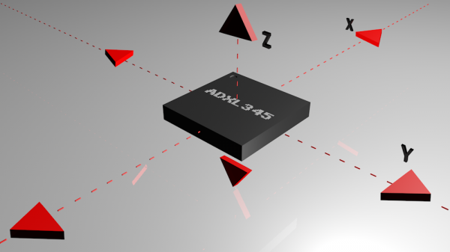
Accelerometer

Slide 5
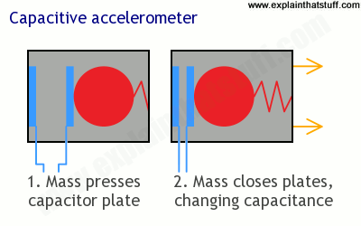
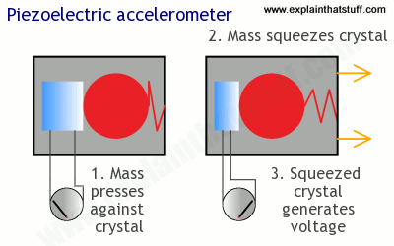

Slide 6
What Next?
Sensor
Know what the sensor does
Microcontroller
How to get your microcontroller to understand it
Application/Implementation
How to develop the logic for the application

Slide 7
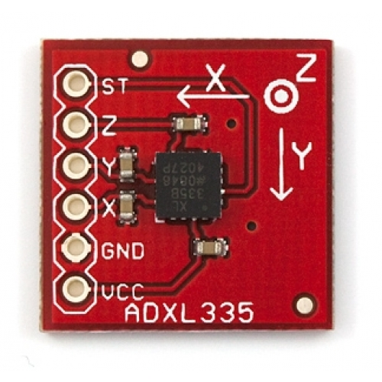
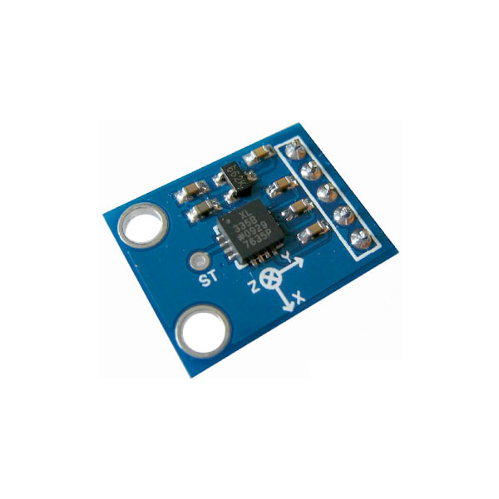
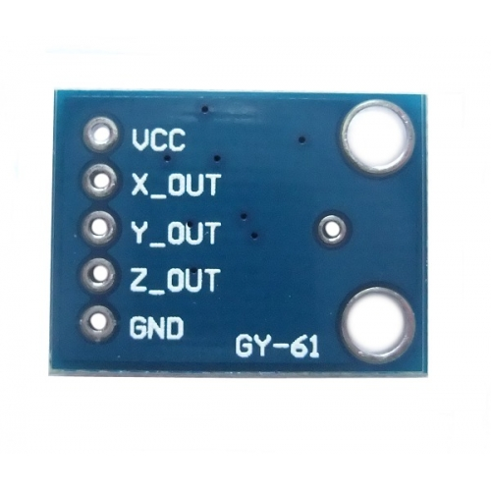
ADXL335

Slide 8
Interfacing with Arduino
Pin Connections:- (Picture)
ADXL335 | Arduino
Vcc | 5v or 3v
GND | GND
X_Out | A0
Y_Out | A1
Z_Out | -
ST | -

Slide 9
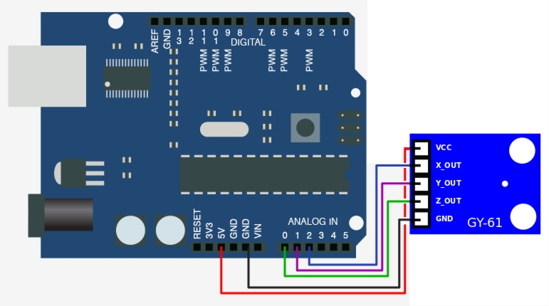

Slide 10
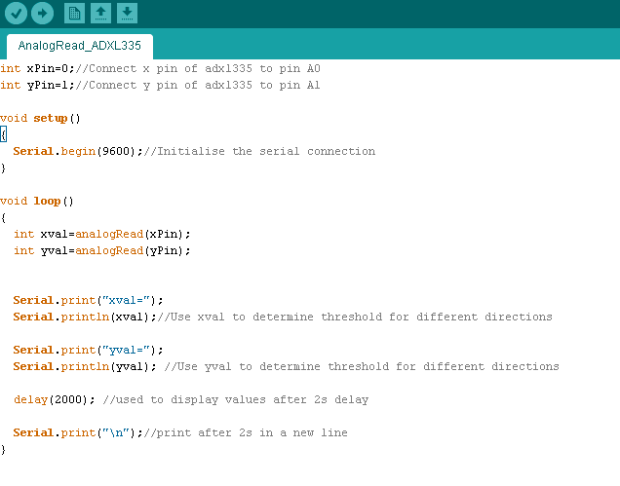
Code

Slide 11
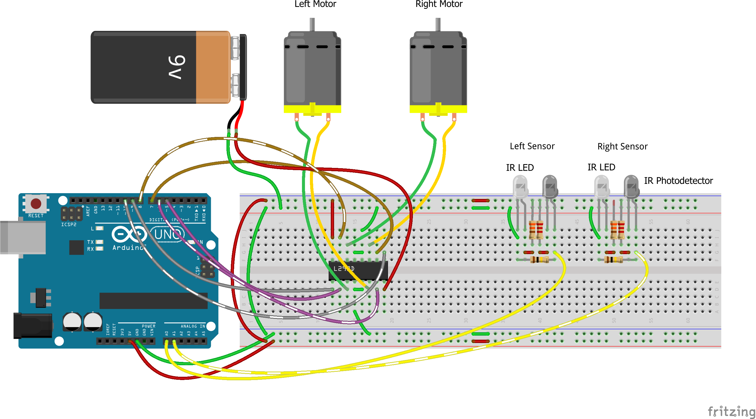
Review Line Follower

Slide 12
Disconnect the IR Sensors
Change the existing code to test the following:-
Forward Motion
Backward Motion
Right Motion
Left Motion

Slide 13
ADXL335 Calibration
Same setup as implemented in the interfacing of the accelerometer
Understanding the values given by the accelerometer from hand gestures
Defining boundary ranges for each motion and stationary state
Steps to be Followed:-
Read the X_Out and the Y_Out values for specific movement
Observe the possible range of the values
Repeat the above steps for each hand gesture.

Slide 14
Calibration Code

Slide 15
After Calibration
We have the following :-
Set of values from ADXL335 for each hand movement
Tested out the line follower without the IR Sensors
ADXL335 is interfaced with the arduino
What we need to do next :-
Change the code from the line follower bot to include accelerometer
Change the logic to use the values we have configured
Test out the bot
Repeat the process of calibration
Try not to crash the bot

Slide 16
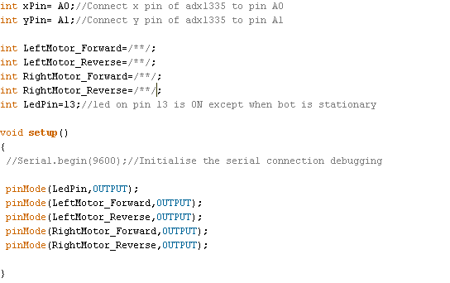

Slide 17
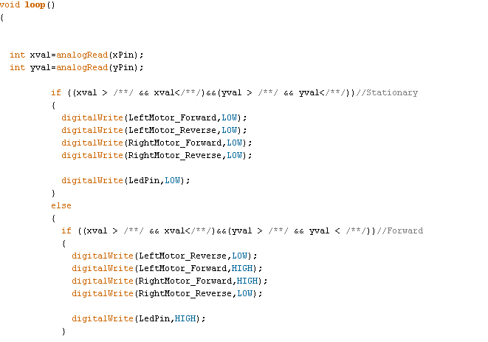

Slide 18
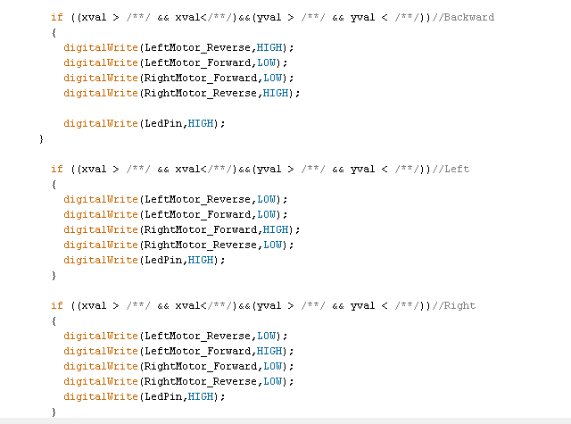
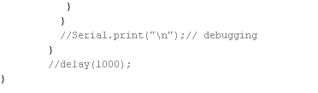

Slide 19
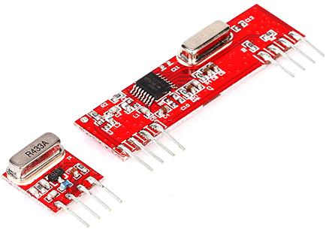
Go Wireless
What do we need?
A medium for wireless communication – Bluetooth or Radio Module
Another Microcontroller
How are we going to do it?
Use the radio module

Slide 20
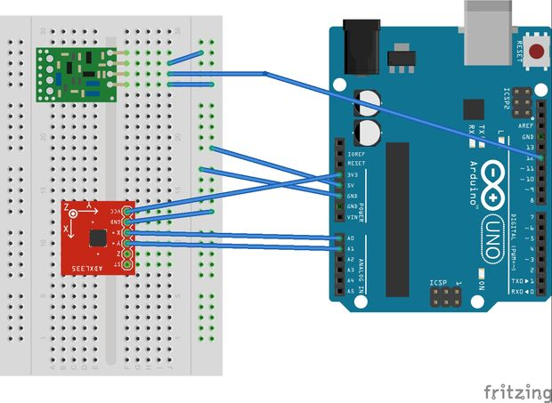
Transceiver

Slide 21
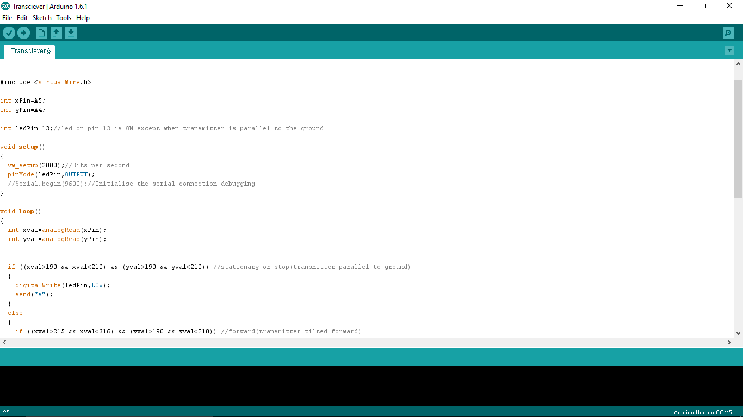

Slide 22
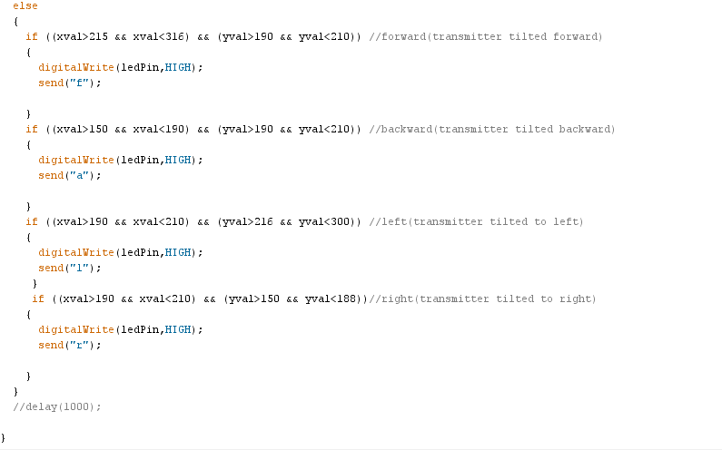

Slide 23
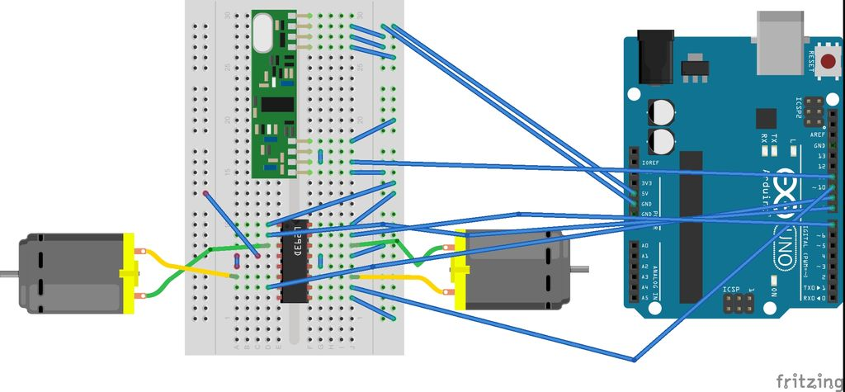
Receiver

Slide 24
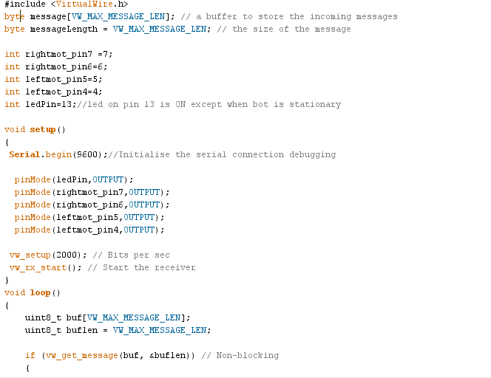

Slide 25
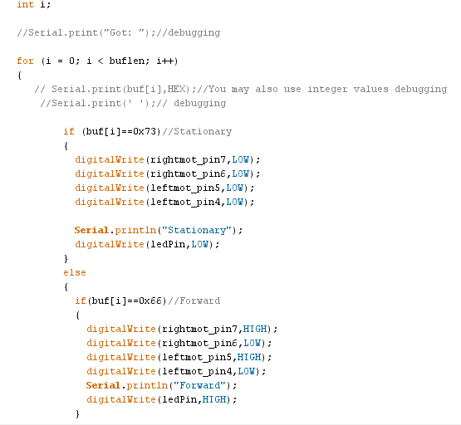

Slide 26
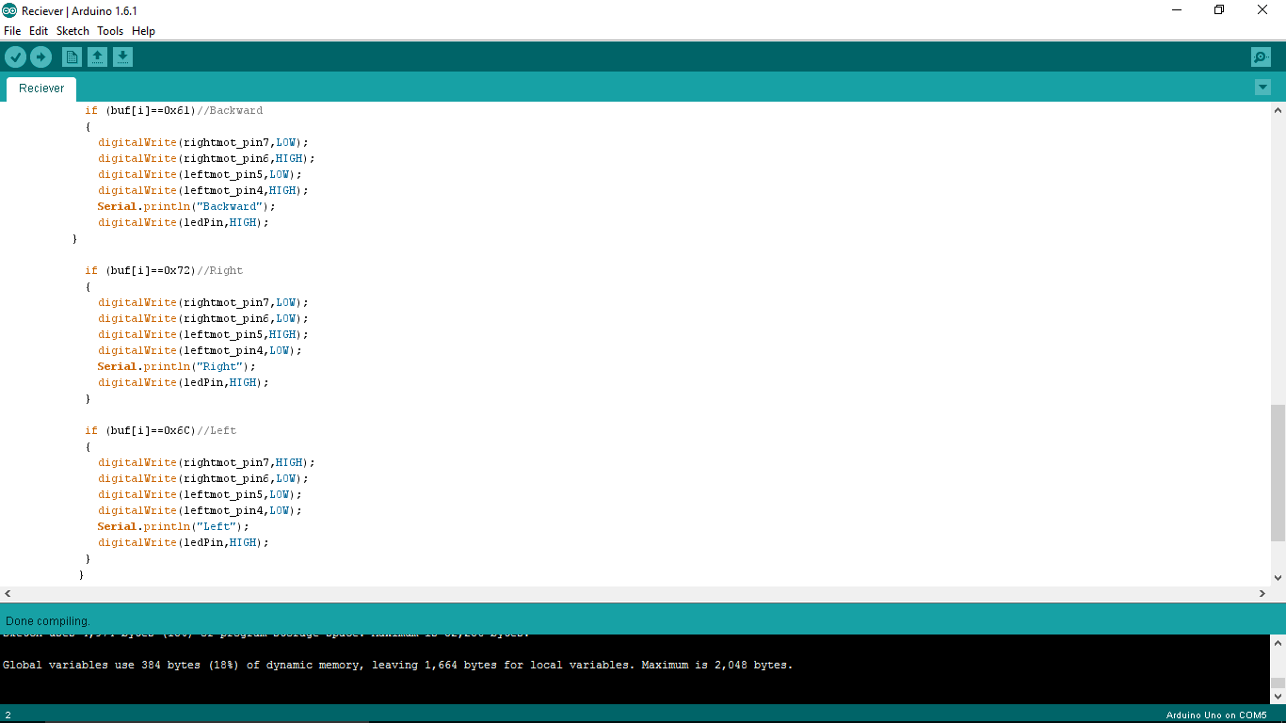
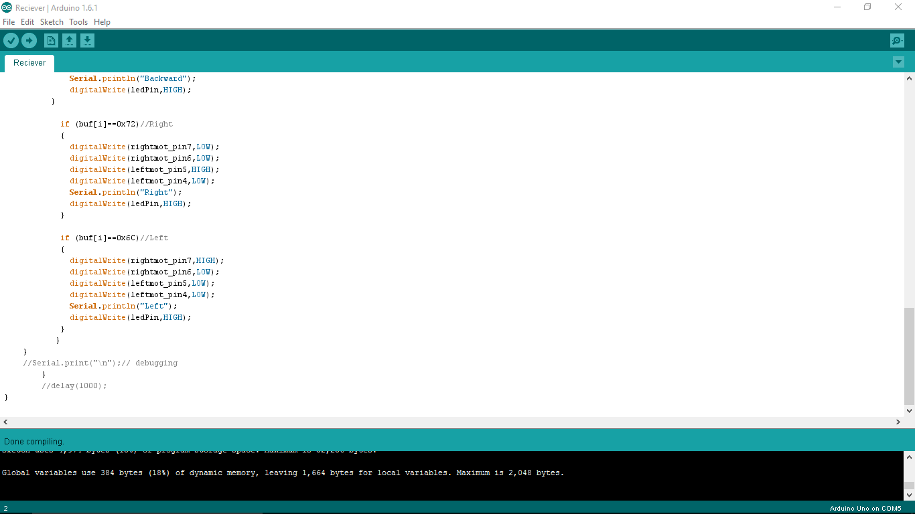

Slide 27
Conclusion

